Slide 1






Rethinking the Role of Motivation in Empathic Accuracy within Romantic
Relationships
A Systematic Review
Cloé Rose Cetko *, Lesley Verhofstadt**, Nikki Taelemans**, Adem Kurtoglu * , Sarah Galdiolo*
*Department of Clinical Psychology, University of Mons, Belgium
** Department of Experimental Clinical and Health Psychology, University of Gent, Belgium

Slide 2


Empathic Accuracy (EA)
“The extent to which individuals can accurately infer another person’s unspoken thoughts and feelings as they spontaneously occur during the course of natural interactions” (Ickes, 1993, p. 588)
Plays a central role in promoting relationship functioning
However
EA
when individuals are motivated to understand their partner
EA varies across individuals, relationships & contexts
EA may emerge from motivational processes
when individuals are NOT motivated to understand their partner
EA
The Gap
- Motivation (= the drive to understand another’s internal state) remains inconsistently conceptualized
- Little attention has been given to identifying which motives (=reasons) lead individuals to engage in or avoid empathically accurate understanding
Gordon & Chen (2016) ; Verhofstadt et al. (2016) ; Verhofstadt et al. (2008) ; Sened et al. (2017) ; Hinnekens et al. (2018) ; Ge et al. (2026) ; Zaki (2014) ; Ickes & Cheng (2011) ; Smith et al. (2011) ; Ickes (2011)

Slide 3
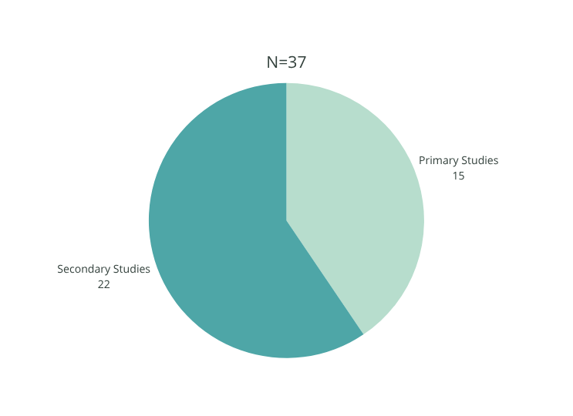
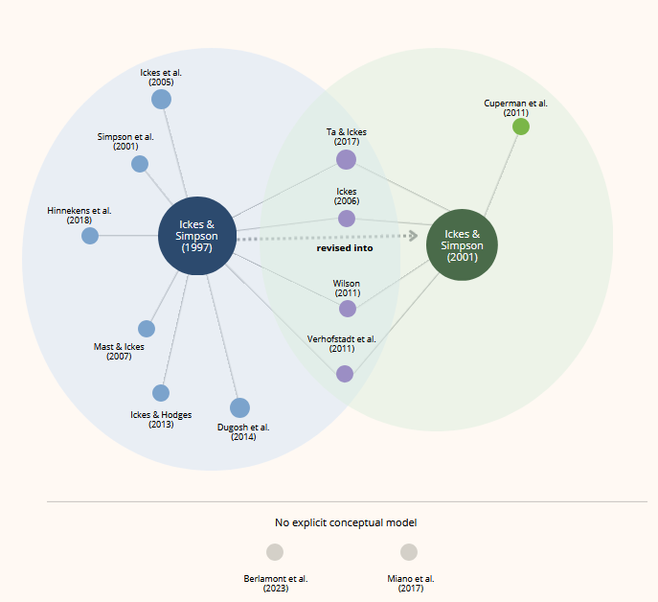
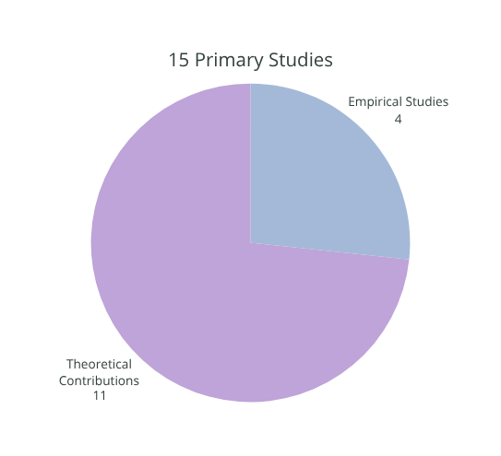
Sample
Conceptual structures
⟶ Motivation is more often addressed indirectly than explicitly operationalized in relation to EA
⟶ 13 records explicitly relied on the Empathic Accuracy Model
⟶ Explicit discussions of motivation in relation to EA within romantic relationships are predominantly grounded in theoretical work

Slide 4


Data was systematically extracted across studies based on the theoretical framework proposed by Ickes and Simpson (1997, 2001)
Identified Pattern
Context
Factor
Motive
Orientation
  The interactional context can mobilize specific factors, which in turn influence the motives that make partners approach VS avoid empathic inferences
Example: In a threatening context, partners with anxious attachment style may be motivated to approach accurate inferences to decrease their insecurity and stress
Threatening
Non-Threatening
Intra-individual
Relationship-dependent
Self-serving
Partner-serving
Relationship-serving
Approach
Avoid
Motivation to achieve EA is dynamic, arising from the interplay between
•Intra-individual/relationship-dependent factors
&
•Interactional context
Perspectives
Examine intra-individual & relationship-dependent factors within specific contexts
  Identifying which factors are activated in different interactional contexts
  Determine how these activated factors influence partners’ motivation to be empathically (in)accurate
Explicitly identify motives within specific contexts
Empirically assess motivation in relation to EA when exploring its variance in romantic relationships
Example from Dugosh et al. (2014)

Slide 5


Thank
you!
Method - PROSPERO
References
Please feel free to reach out ! ⟶ Cloe.cetko@umons.ac.be

